Slide 1
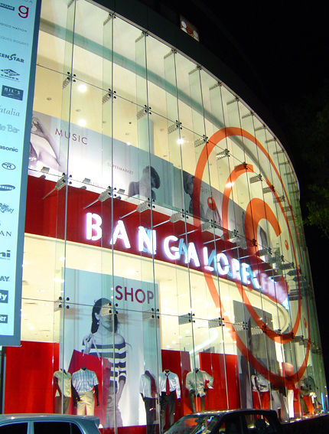
Find the Best Location to Open a Coffee Shop in Central Bangalore Area
Capstone Project - The Battle of Neighborhoods

Slide 2
Background
Selecting a location for a business is one of the most important decisions in running a business.
Business decision makers need to consider different factors in finding the right location for the business, such as distance, common venues in that place, market factors, and the factors that will affect their demand and revenue.
This project can help those who are planning to open a new business such as an coffee shop and need to find the best location for the shop in a city.

Slide 3
Business Problem
To find the best neighborhood in Central Bangalore to open an coffee shop
A suitable neighborhood which is close enough to some amenities and venues, has fewer competitors, and is affordable to rent
An coffee shop is good to be near a place where many people visit such as near a cinema, park, garden, IT parks etc.
A neighborhood that has fewer competitors is less risky for starting a new business.

Slide 4
Data
Extract the information about the neighborhoods of Central Bangalore using the following website and BeautifulSoup website scraping library:https://en.wikipedia.org/wiki/List_of_neighbourhoods_in_Bangalore
Transform the data into pandas dataframe
Use GeoPy Python package to get the latitude and the longitude coordinates of all the neighborhoods of Boston
Map the neighborhoods using Folium Python library
Use Foursquare API to get information about some venues around these neighborhoods

Slide 5
Foursquare API
Looking for a group of venues in walking distance (500 meters) of each of the neighborhood:
Movie Theater, Playground, Park, Garden, Water Park, General Entertainment, Stadium, Amphitheater, Aquarium, Street Art, Beach, Recreation Center, Pedestrian Plaza venues) and also IT Parks
These venues are places that many people usually visit them for entertainment and hence we will have good demand for coffee around them.
Looking for Coffee shops within walking distance of each of the neighborhoods.
To get an understanding of the competitors in each neighborhood.

Slide 6
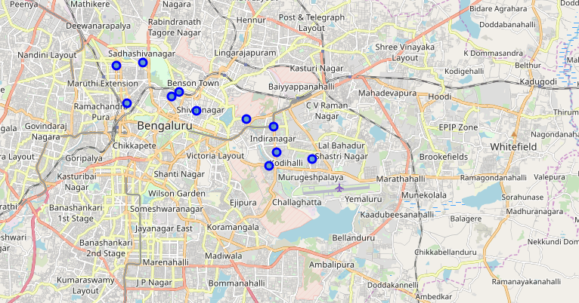
11 neighborhoods of Central Bangaloreselected for this study

Slide 7
Methodology
Cluster the neighborhoods using k-means to cluster the neighborhood into 4 clusters based on the frequency of different venue categories around them.
Select the neighborhood within the limits that has fewer coffee shop a,café nd more of other venue categories around.

Slide 8
Results and Discussion
Seshadripuram(cluster 1),Jeevanbheemanagar(Cluster 3) and Cantonment Area (in cluster 4) are the best places of the neighborhood to open a coffee shop in Central, Bangalore
It has the greatest number of total venues and is expected to attract many people to visit.

